Slide 1
Alcohol Sensing Alert With Engine Locking System
TEAM MEMBERS’S:
1.PRITHVIRANI
2. SNEHA TENGLI

Slide 2
INTRODUCTION
Driving under the influence of alcohol is a major cause of road accidents globally. To prevent such mishaps, we propose a smart embedded system that detects the presence of alcohol in a driver's breath, sends alerts via GSM, provides vehicle location via GPS, and locks the engine to prevent drunk driving.

Slide 3
OBJECTIVES
To detect alcohol consumption in the driver’s breath using an alcohol sensor .
To lock the vehicle engine if alcohol is detected above a permissible level .
To alert authorities or family members via GSM .
To share real-time GPS coordinates for location tracking .
To increase road safety and reduce drunk-driving accidents

Slide 4
COMPONENTS REQUIRED
Arduino NANO
Main microcontrollerMQ-3
Alcohol sensor detects alcohol vapours in breath
GSM Module (SIM800L)Sends SMS alerts
GPS Module (NEO-6M)Tracks and transmits vehicle location
Relay Module controls engine locking mechanism
12V DC Motor / Engine Simulated vehicle engine
Power supply battery or adapter for powering modules
LCD Display (16x2) displays status messages (optional)

Slide 5
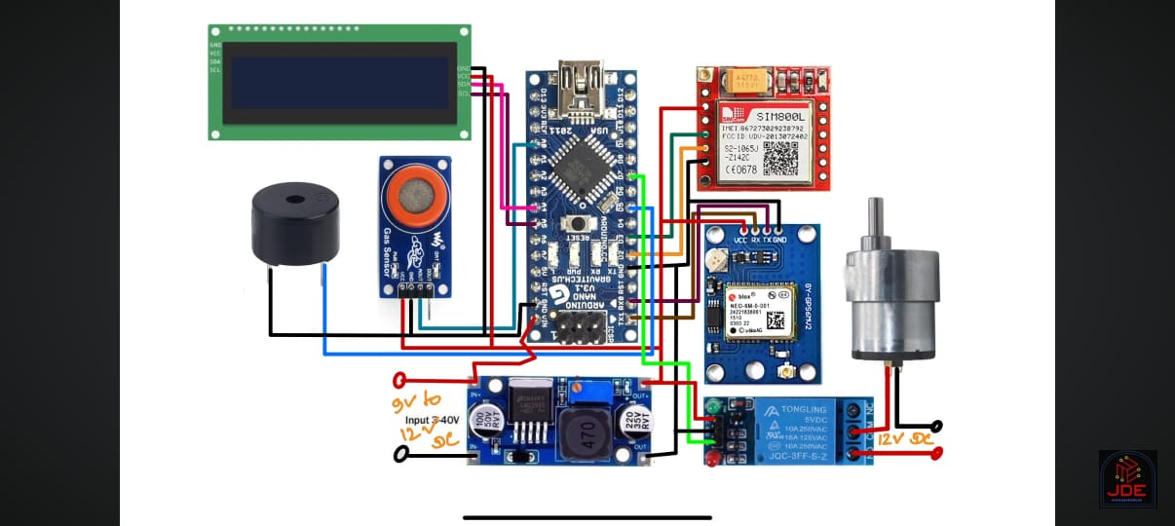
CIRCUIT DIAGRAM

Slide 6
WORKING PRINCIPLE
Alcohol Detection: The MQ-3 sensor continuously samples air for alcohol vapors.
Signal Processing: The analog signal is processed by the Arduino and compared with a predefined threshold.
Alert & Lock : If alcohol is detected above the threshold :
GSM module sends an alert SMS to a predefined number .
GPS module captures the real-time location and includes it in the
SMS
Relay disconnects engine ignition to prevent vehicle operation .
Buzzer sounds to notify of detection .
If no alcohol is detected : Engine remains unlocked and functional.

Slide 7
FEATURES
Real-time alcohol detection
Automatic engine locking
SMS alerts to authorities or family
GPS location tracking
Easy to integrate into vehicles

Slide 8
ADVANTAGES
Prevents drunk driving and road accidents
Reduces law enforcement workload
Easy to install and cost-effective
Real-time updates to emergency contacts

Slide 9
CONCLUSION
This system combines alcohol detection with vehicle control and communication technologies to offer an effective solution for improving road safety. The integration of GSM and GPS ensures real-time alerting and tracking, while engine locking physically prevents potential accidents due to drunk driving.

Slide 10
FUTURE ENHANCEMENTS
Integration with mobile apps for live tracking
Adding camera modules for image capturing
Cloud storage for alert logs
AI-based driver behaviour monitoring

